Slide 1
History Of C Programming
Mohamed Rahman Shareff S

Slide 2
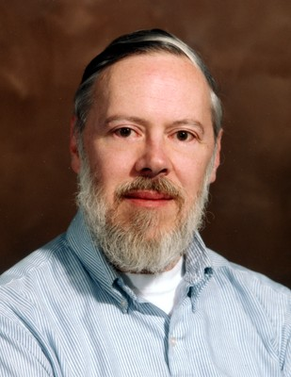
History Of C
Dennis Ritchie, the founder of C programming language.
Developed C in the year of 1972 at Bell Laboratories(U.S.A)
C was originally first implement on the DEC PDP -11 computers
C is very flexible and versatile allowing maximum control with minimal commands

Slide 3

Features Of C:
High level language
Structured language
Rich library
Extensible
Recursion
Pointers
Faster
Memory Management

Slide 4
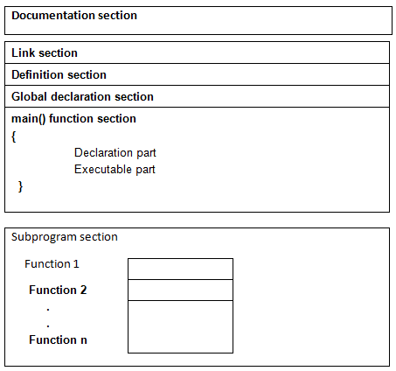
Basic Structure Of C Program

Slide 5
Documentation Section
This Section consists of comment lines which include
1. The name of Programmer
2. The author and
3. Other details like time and date of writing the program
It helps anyone to get an overview of the program.
Comment line indicates the purpose of the program.
NOTE : It is represented as /*…………………………..*/

Slide 6
Link Section
Consists of the header files of the functions and symbolic constants that are used in the program.
It provides instructions to the compiler to link functions from the system library.
Ex: 1. #include<stdio.h> tells the compiler to include information about the standard input/output library.

Slide 7
Definition Section (Global Declaration Section)
The global variables that can be used anywhere in the program are declared in global declaration section.
This section also declares the user defined functions.

Slide 8
main() Function Section
It is the user defined function. Every Program has one main() function from where actually program is started .
The statements in the function are enclosed within the pair of curly braces

Slide 9
main() Function Section
The main( ) function can be anywhere in the program but in general practice it is placed in the first position..
This section contains two parts,
Declaration Part : all local variables are declared
Executable part: consists of Executable statements.
These two parts must be written in between the opening and closing braces.
Each statement in the declaration and executable part must end with a semicolon (;).
The execution of program starts at opening braces and ends at closing braces.

Slide 10
Braces ()
Every C program should have a pair of curly braces ({, }).
The left braces indicates the beginning of the main ( ) function and
The right braces indicates the end of the main ( ) function.
These braces can also be used to indicate the user-defined functions beginning and ending.
Used in compound statements.

Slide 11
Local Declarations
All the variables used in main ( ) function are declared in the local declaration section is called local variables.
Arrays, functions, pointers etc. are also declared within a function.
Subprogram Section
Contains all the user defined functions that are used to perform a specific task.
These user defined functions are called in the main() function

Slide 12
THANK YOU

